Slide 1
Programming Fundamentals LAB 01
Instructor : Isra Naz

Slide 2
Lab Evaluation
Weekly lab tasks
1 Lab sessional before Midterm
1 lab sessional after Midterm
On spot Vivas
Semester Project
80% attendance required

Slide 3
INTRODUCTION TO MICROSOFT WORD FOR WINDOWS

Slide 4
OBJECTIVES
Getting used to Graphical User Interface in Windows Operating Systems.
Understanding what word processors are and learning how to prepare a broad range of documents by using Microsoft Word.

Slide 5
Word Processors
Microsoft word is a sophisticated Word Processing Package that provides a range of features for document creation and formatting, including many desktop publishing type features, graphics and drawing utilities.

Slide 6
MS WORD USAGE
Word can be used to produce many document types including:
Letters
Labels
Memos
Reports
Curriculum Vitae
Advertisements

Slide 7
Tasks

Slide 8
HOW TO START WITH MS WORD?
Click “START”→PROGRAMS→MICROSOFT WORD

Slide 9
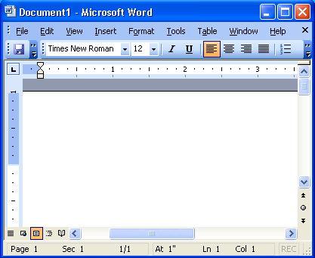
Word: Document
DOCUMENT:
When you start Word, a new, empty document file is automatically created, so you face an empty page. A document file is a file that contains information that user can view or hear.
THE CURSOR:
It is the visual screen element that indicates our exact position in the document.
THE INSERTION POINT:
It is a flashing screen element that indicates the position in the document where text will be entered when we are typing.
THE MOUSE CURSOR:
It is the on-screen graphic representation of the position of the mouse.

Slide 10
BARS
TITLE BARS:
Displays the name- the type of document. Three toolbars are located at the top of the word screen. These will be used for shortcuts in many of the activities. If you don’t see one of the toolbars, select VIEW/TOOLBARS and select the missing toolbar.
MENU BAR:
Click any of the words on this row to see menu options icon the category.
STANDARD TOOLBAR:
Icons in this row provides shortcuts to many tasks accessible through the menu bar (open, print, cut, paste) as well as handy features (spelling and grammar, insert table, show, hide).
FORMATTING TOOLBAR:
This row controls the format of text (style, font, size, alignment, color, borders).

Slide 11
USING THE MENUS FILE MENU:
CREATE A NEW DOCUMENT:
Open file menu select NEW or press CNTRL+N
New creates a new, empty document
OPEN AN EXISTING DOCOMENT:
Open file menu select OPEN or press CNTRL+O
Opens a document which was created and saved before
CLOSE A DOCUMENT:
Open file menu select CLOSE or click close icon
Closes the currently open, active document
SAVE A DOCUMENT:
Open file menu select SAVE or press CNTRL+S
Saves the document to a disk (permanent storage device)

Slide 12
USING THE MENUS FILE MENU:
SAVE AS:
Open file menu select SAVE or press CNTRL+S
Used to save another (one more) copy of a file, with a different name.
PAGE SETUP:
Used to set the page margin, size, and layout.
PRINT THE DOCUMENT:
Used to take a print-out of the document.
EXIT:
Used to quit from Word.

Slide 13
EDIT MENU
UNDO TYPING:
Open edit menu select UNDO TYPING or press CNTRL+Z
Used to cancel the last action (operation) you have made
REPEAT TYPING:
Open edit menu select REPEAT TYPING or press CNTRL+Y
Used to do a cancelled action once again,
FIND:
Open edit menu select FIND or press CNTRL+F
Used to search for some word or sentence in your document.
CUT:
Open file menu select CUT or press CNTRL+X
Removes the information from an application and places it on the clipboard.

Slide 14
Edit Menu
COPY:
Open file menu select COPY or press CNTRL+C
Copy leaves the information in an application and places a copy of it on the clipboard.
PASTE:
Open file menu select PASTE or press CNTRL+V
Copies the information from the clipboard and places it into an application.
SELECT ALL:
Open file menu select SELECT ALL or press CNTRL+A
Used to select the whole document.

Slide 15
VIEW MENU
TOOLBARS:
Open view menu select TOOLBARS
Used to add toolbars.
HEADER AND FOOTER:
Open view menu select HEADER AND FOOTER
WEB LAYOUT:
Used to create a web page document.
PRINT LAYOUT:
Used to see how text, graphics and other elements will be positioned on the page.

Slide 16
VIEW MENU
NORMAL:
Used for typing editing, and formatting text.
OUTLINE:
Used to look at the structure of the document and to move ,copy, and recognize text by dragging headings.
DOCUMENT MAP:
Displays the lists of headings in the documents.

Slide 17
INSERT MENU
BREAK:
Open insert menu select BREAK
Used to insert page break, column brake, text wrapping break.
PAGE NUMBERS:
Open insert menu select PAGE NUMBERS
Used to insert page numbers on the top, bottom, centre, of the document.
SYMBOL:
Open insert menu select SYMBOL
Used to insert any symbol which is not present on the keyboard..
PICTURE:
Open insert menu select PICTURE
Used to draw or insert any picture.

Slide 18
FORMAT MENU
BULLETSAND NUMBERING:
Open format menu select BULLETS AND NUMBERING
Used to insert numbers or any sign before each line
BORDERS AND SHADING:
Open format menu select BORDERS AND SHADING
Used to insert borders and color to the page.
COLUMNS:
Open format menu select COLUMNS
Used to divide the written text in any numbers of columns.

Slide 19
FORMAT MENU
CHANGE CASE:
Open format menu select CHANGE CASE
Used to change the case of the letters by applying small capital or all capital formatting.
BACKGROUND:
Open format menu select BACKGROUND
Used to give a color to the document.

Slide 20
TOOLS MENU
SPELLING AND GRAMMAR:
Open tools menu select SPELLING AND GRAMMAR
Used to check the spellings and grammar faults in the document.
WORD COUNT:
Open tools menu select WORD COUNT
Give information about the numbers of words, paragraphs, lines pages.
AUTO CORRECT OPTION:
Open tools menu select AUTO CORRECT OPTION
Used to automatically correct the spellings of the words while typing.

Slide 21
TABLE MENU
INSERT TABLE:
Open table menu select INSERT TABLE
Used to insert table consisting of any number of rows and columns.
DELETE:
Open table menu select DELETE
Used to delete any column, row., table.
SELECT:
Open table menu select SELECT
Used to select a table or row or column.
SORT:
Open table menu select SORT.
Used to give text a desired direction in the table

Slide 22

Lab Tasks
Create Business Cards using Shapes, text, and colors.

Slide 23
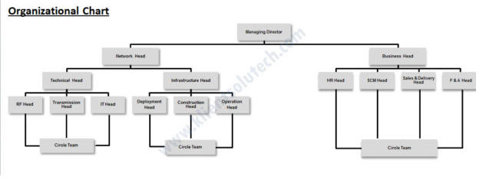
Lab Tasks
Use smart art and create organization charts

Slide 24
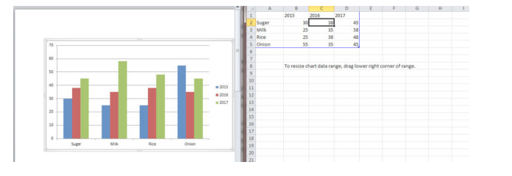
Lab Tasks
Create a chart and show the product price comparison between 2015, 2016, and 2017.

Slide 25

LAB TASKs
Take a double-column book or newspaper and design or create a similar paragraph style in the word document.

Slide 26
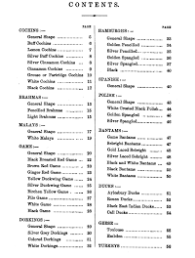
Lab Tasks
Make books content page or index page

